Slide 1

CASE STUDY
BRAZIL HOUSING

Slide 2
Introduction about the Dataset:
Castro Brazila Inc. , a top real estate management firm with a nationwide presence in Brazil , wishes to help people choose an alternate city to relocate to.
Objective:
To help the firm figure out suitable cities for relocation for Bachelors, for Mid-size Families, and for large families.

Slide 3
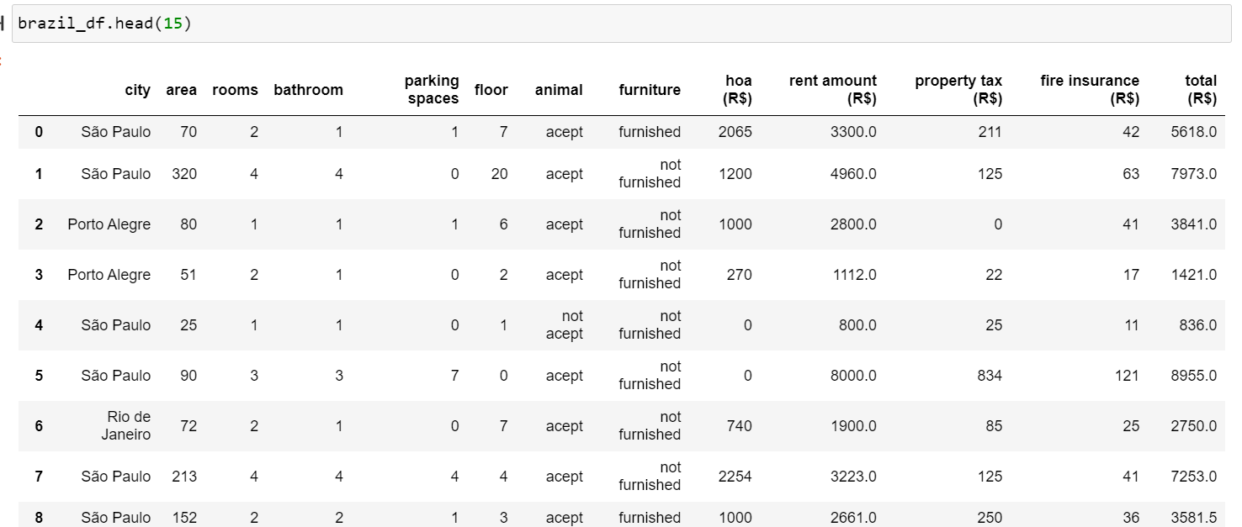
After Loading the given Dataset into a data frame called brazil_df:
The below dataset contains: 10692 rows and 13 columns.

Slide 4
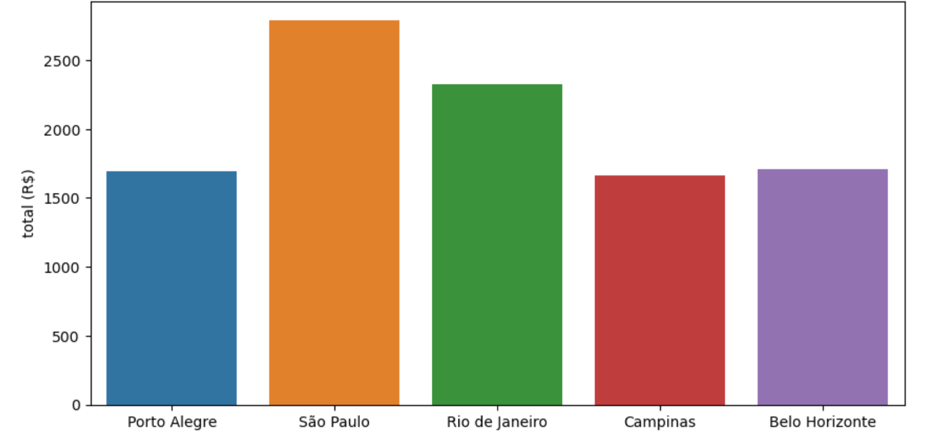

Slide 5
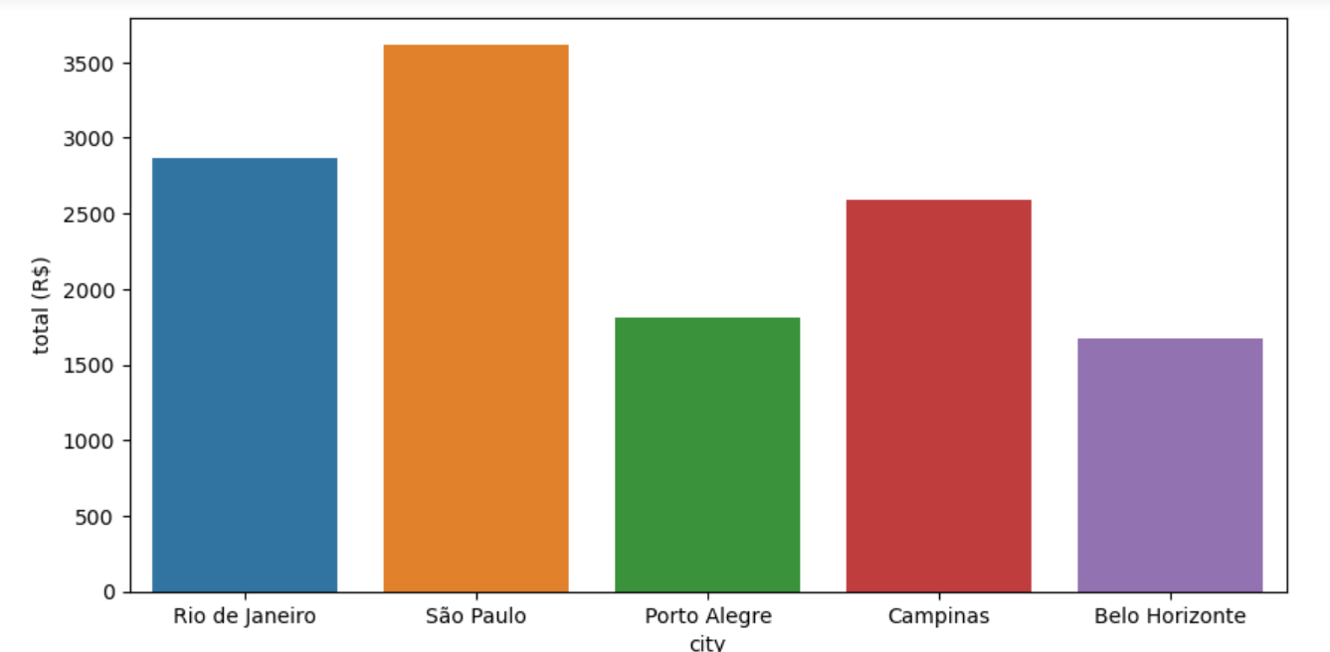

Slide 6
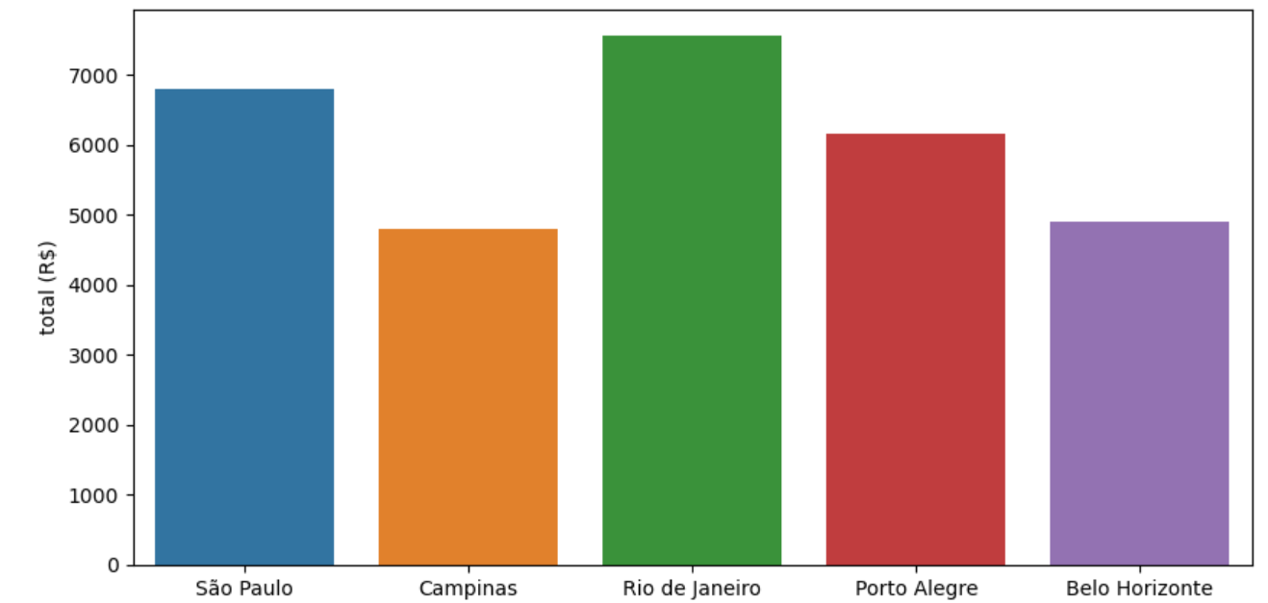

Slide 7
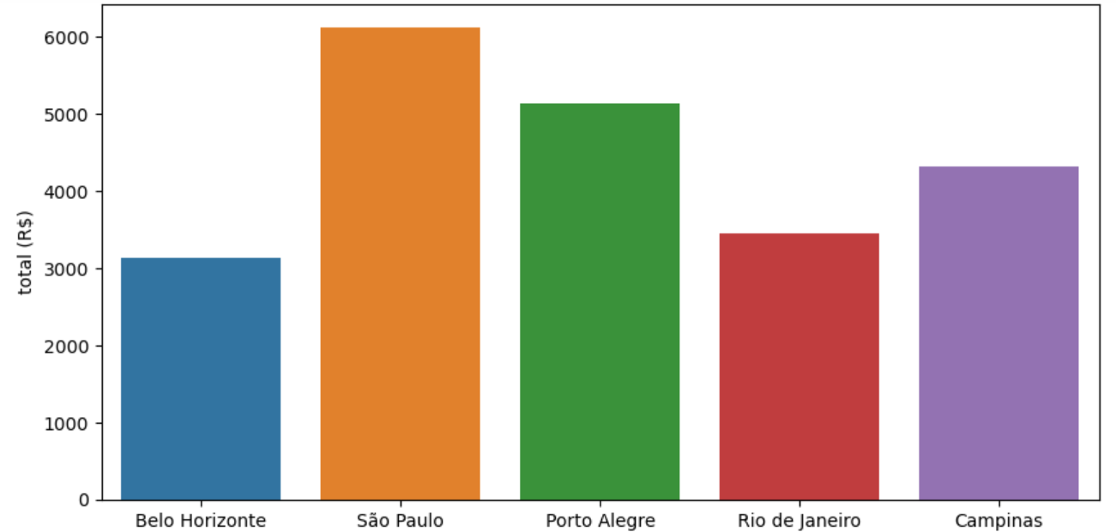

Slide 8
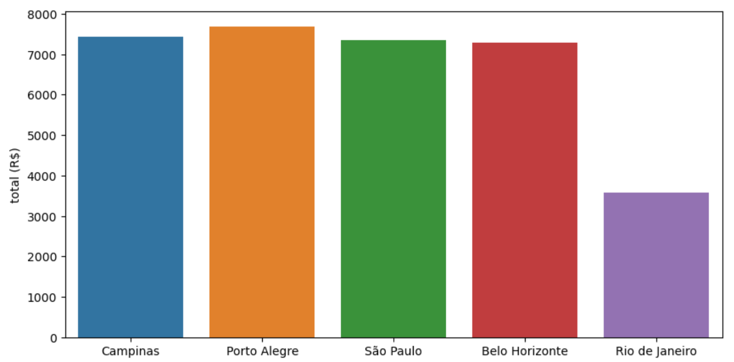

Slide 9
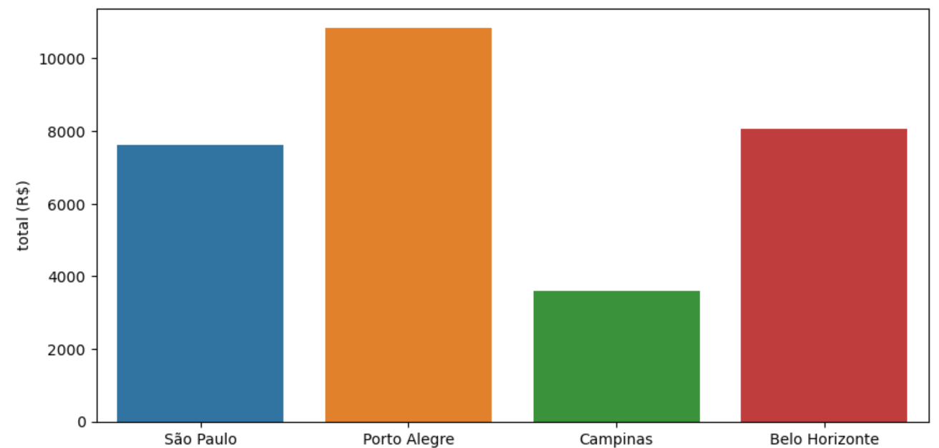

Slide 10
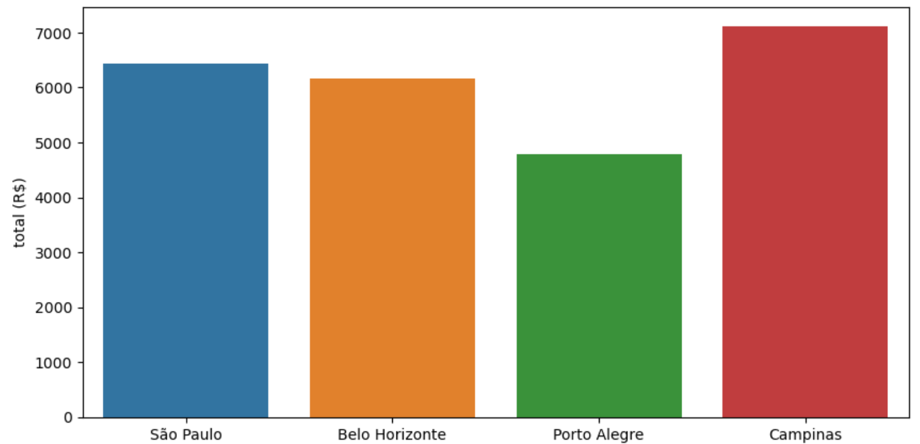

Slide 11
Overall Summary:
By the Analysis we found that-
For Bachelors:
The best City which includes pets and furnished rooms with suitable conditions at lower prices is City Belo Horizonte.
For mid-size families:
City with cheap price and houses which are pet friendly and furnished rooms is Campinas.
City with cheap price, which includes no pets and unfurnished rooms is Belo Horizonte.
For large families:
City with affordable prices which do not allow pets and have unfurnished rooms is Campinas.
City with affordable price which allow pets and furnished rooms is Porto Alegre.

Slide 12
THANK YOU
BY –
ARJUN MAURYA

